Slide 1
Motor power modulations during imagined movements
Neuromatch 2022
Brenda Qiu | Jessica Alexander Juan Pablo Botero | Kurt Lehner | Lavanya M K

Slide 2
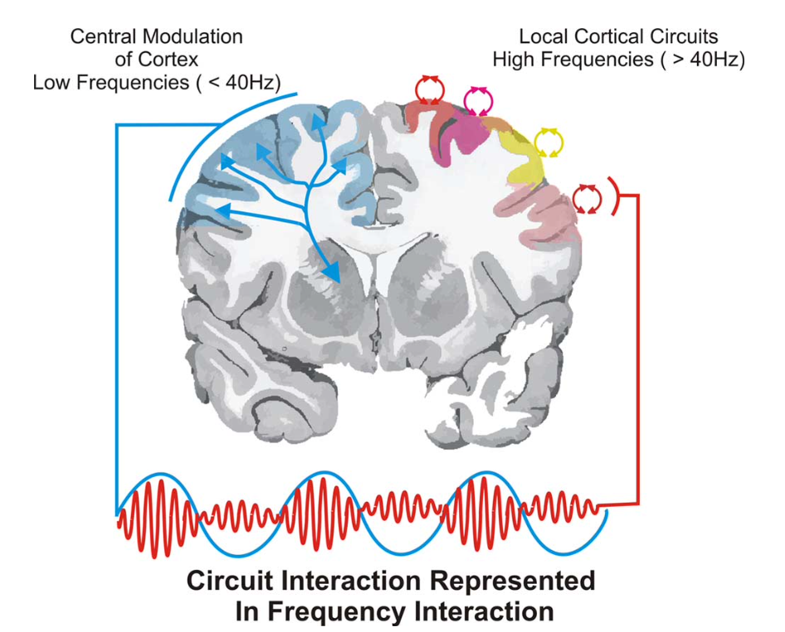
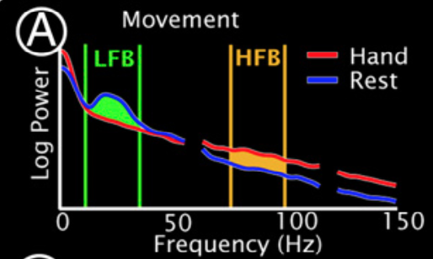
Background
Miller et al. (2010)
High beta power inhibits movement
Event related desynchronization (ERD) is necessary for movement to occur
High gamma frequency increases during movement
Schalk and Leuthardt (2011)
Notes:
EEG and ECoG are able to measure population cortical potentials. ECoG involves the placement of surface electrodes on the surface of the brain under the bone and leathery dura mater. This increases the spatial resolution and decreases noise of neuronal recordings compared to EEG. As shown in the figure on the right, power of cortical signals in low frequencies is thought to represent central modulation of cortical activity via thalamocortical or other subcortical interactions. Power in high frequencies is thought to represent local cortical circuit activity.
The figure on the right demonstrates an average power spectrum density during rest in blue and movement in red; the y-axis is power and x-axis is frequency. Prior to movement during rest, high beta power is observed in the motor cortex. The initiation of movement requires “Event related desynchronization” of the beta signal, where beta power decreases. Patients with Parkinsons disease are unable to decrease the beta power in their motor cortex and this is thought to be at least partially responsible for the bradykinesia observed. Simultaneously or slightly later, an increase in high gamma power is observed correlating with actual movement.

Slide 3
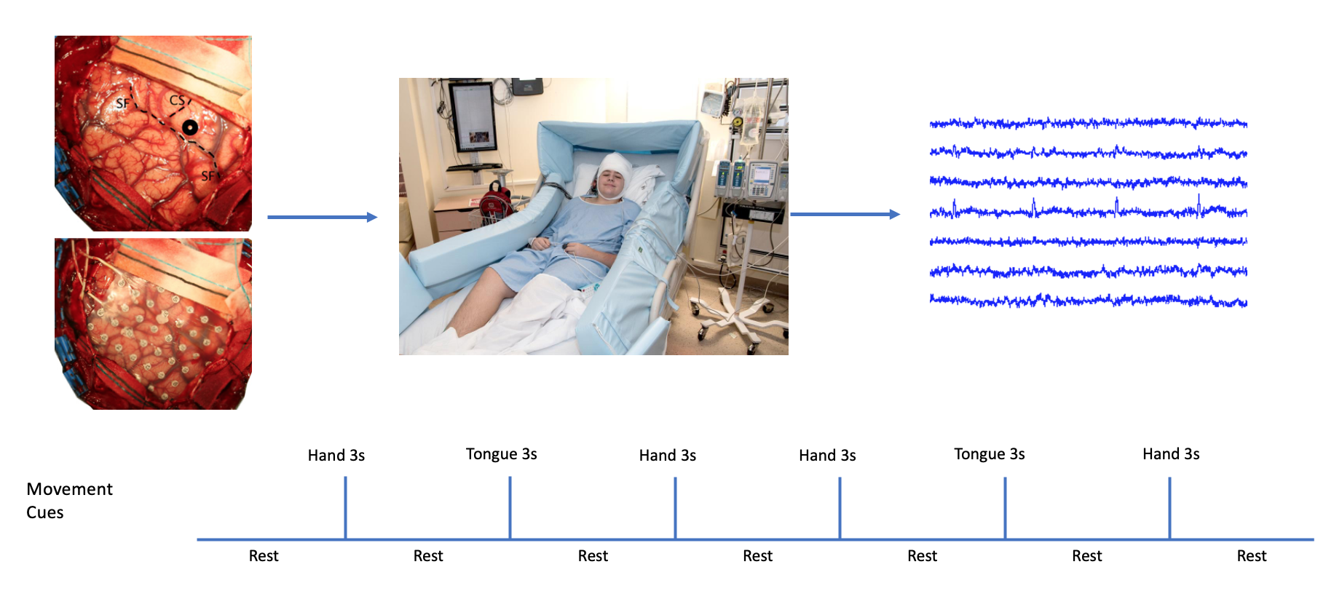
Data
Notes:
With this in mind, we were curious about how these dynamics differed in imagined and actual movement. Subjects undergoing ECoG monitoring for medically refractory epilepsy participated in two interleaved tasks of hand grip and tongue protrusion at rate of once per second (1 Hz), alternating between task and rest cued by a screen. on-screen cue. In the first trial, pateints were asked to complete the actual movement; in the second trial they were asked to “imagine what it would feel like to complete the movement”. Dataglove or sublinguakl EMG were used to verify absence of movement during imagined condition.
hand (synchronous flexion/extension of all fingers)
tongue (protrusion/retraction of tongue with mouth open)
Two conditions: real movement, imagined movement

Slide 4
Aims
Replicate prior ERD/ERS findings
Investigate how power profiles during imagined and actual movements differ
Design and build ML pipeline to classify actual and imagined movements
Notes:
Hypotheses
Similar ERD in beta frequency between actual and imagined
Attenuated changes in high gamma frequency for imagined movements in comparison with actual movements
(with and without high gamma) Low frequency only models will significantly underperform in the discrimination task

Slide 5
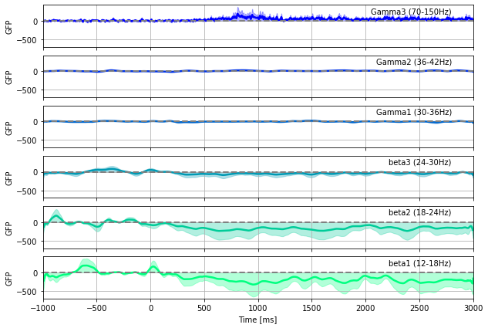
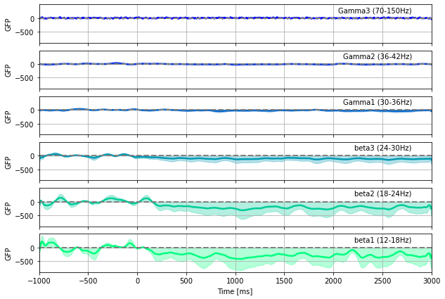
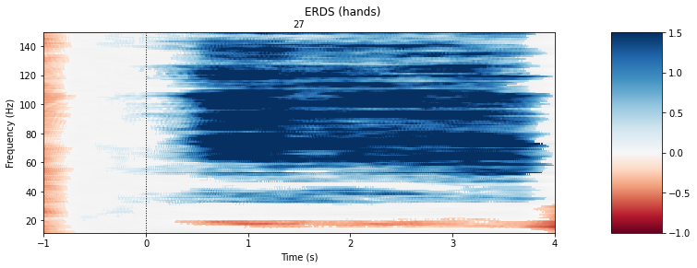
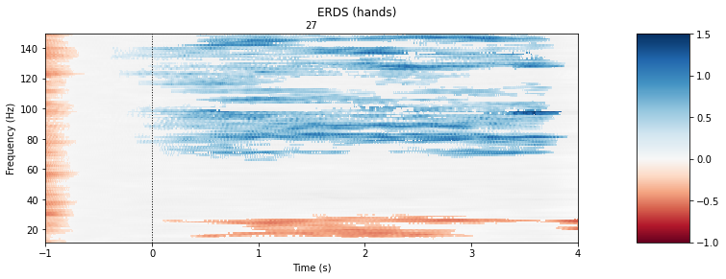
Aim 1: Replicate prior ERD/ERS findings
actual movement
imagined movement
relative change from baseline
relative change from baseline
Notes:
S1 Hand, Electrode 27

Slide 6
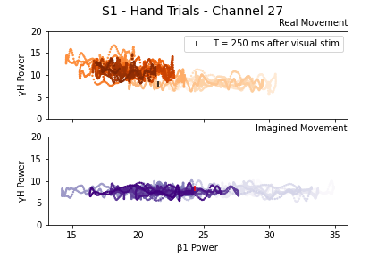
Aim 2: Investigate real v. imagined power
Notes:
S1 Hand, Electrode 27
color (light -> dark) indicates time course over epoch windows (-1000 to 3000 ms)
vertical marker indicates 250 ms after onset of visual stimulus

Slide 7
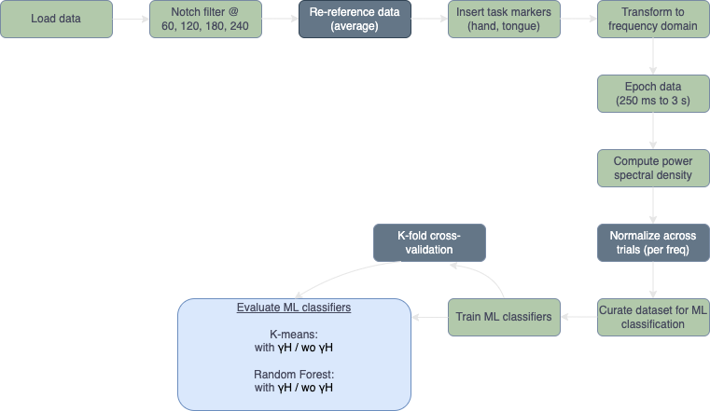
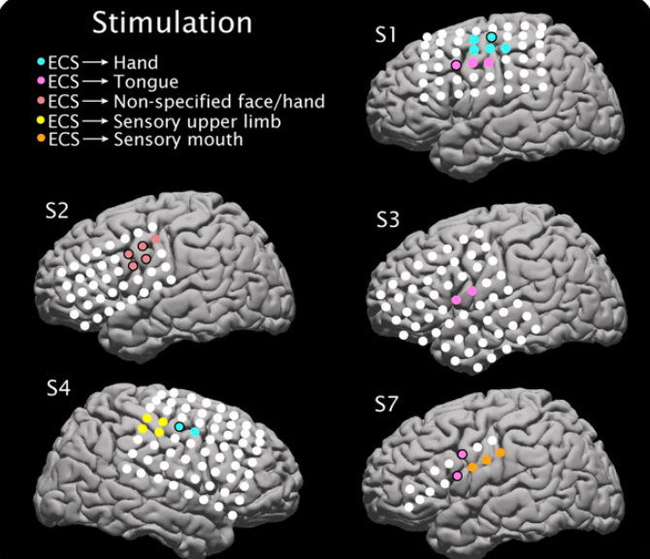
Aim 3
To what extent do lower frequency bands distinguish actual versus imagined movement?
Miller et al. (2010)
*grey boxes not completed due to project time constraints

Slide 8
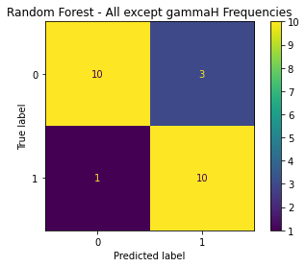
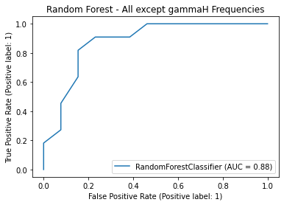
Aim 3: Classify without high gamma

Slide 9
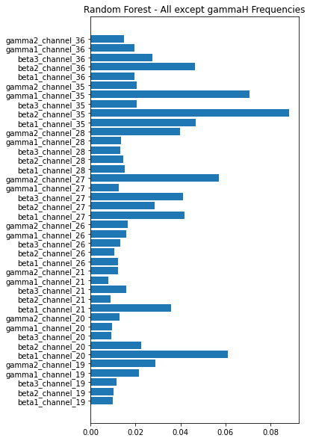
Aim 3: Classification without high gamma

Slide 10


Conclusions
Similar ERD in beta frequency between actual and imagined
Attenuated changes in high gamma frequency for imagined movements in comparison with actual movements
Low frequency only models will significantly underperform in the discrimination task
Better performance than anticipated (but models with high gamma still perform better...)

Slide 11
Limitations
generalizability of findings: single epileptic subject
time constraints: simplified preprocessing, incomplete analysis/validation
Notes:
specific subject population reduces generalizability of findings
project time constraints led us to simplify our preprocessing:
did not re-reference data to the average
did not perform ICA or other methods to identify and remove noisy (or epileptic) epochs in the channels we analyzed
project time constraints led us to simplify our analyses:
did not z-score across trials within bands before classification
single randomized split for training/test (no thorough cross-validation)

Slide 12
Code Availability
https://github.com/jessb0t/motorImagery

Slide 13
References
Gramfort, A., Luessi, M., Larson, E., Engemann, D. A., Strohmeier, D., Brodbeck, C., Goj, R., Jas, M., Brooks, T., Parkkonen, L., & Hämäläinen, M. S. (2013). MEG and EEG data analysis with MNE-Python. Frontiers in Neuroscience, 7(267):1–13.
Harris, C.R., Millman, K.J., van der Walt, S.J. et al. (2020). Array programming with NumPy. Nature 585, 357–362.
Hunter, J.D. (2007). Matplotlib: A 2D Graphics Environment, Computing in Science & Engineering, 9(3):90-95.
Miller, K. J., Schalk, G., Fetz, E. E., den Nijs, M., Ojemann, J. G., & Rao, R. P. N. (2010). Cortical activity during motor execution, motor imagery, and imagery-based online feedback. PNAS, 107(9), 4430–4435.
Miller KJ. A library of human electrocorticographic data and analyses. Nat Hum Behav. 2019 Nov;3(11):1225-1235.
Unterweger, J., Seeber, M., Zanos, S., Ojemann, J. G., & Scherer, R. (2020). ECoG Beta Suppression and Modulation During Finger Extension and Flexion. Frontiers in Neuroscience, 14, 35.
G. Schalk and E. C. Leuthardt, "Brain-Computer Interfaces Using Electrocorticographic Signals," in IEEE Reviews in Biomedical Engineering, vol. 4, pp. 140-154, 2011, doi: 10.1109/RBME.2011.2172408.
Code for creation of the GFP graphics based on the detailed example provided here: https://mne.tools/stable/auto_examples/time_frequency/time_frequency_global_field_power.html

Slide 14




Thanks!
Dr. José Biurrun Manresa, Project TA
Anis Zahedifard, Pod TA
Neuromatch Organizers and Volunteers
Dr. Jason Ritt, Project Mentor

Slide 15
Supplemental Slides

Slide 16
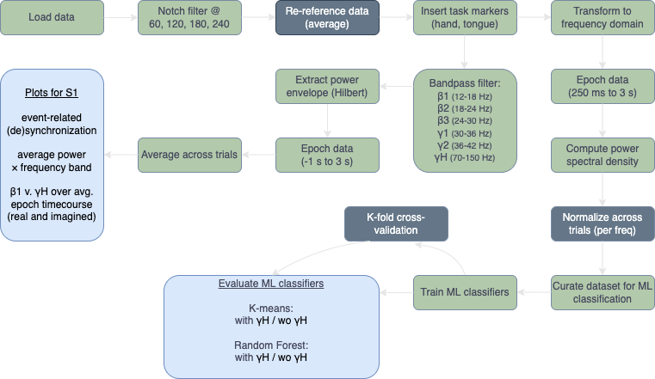
Methods
*grey boxes not completed due to project time constraints

Slide 17
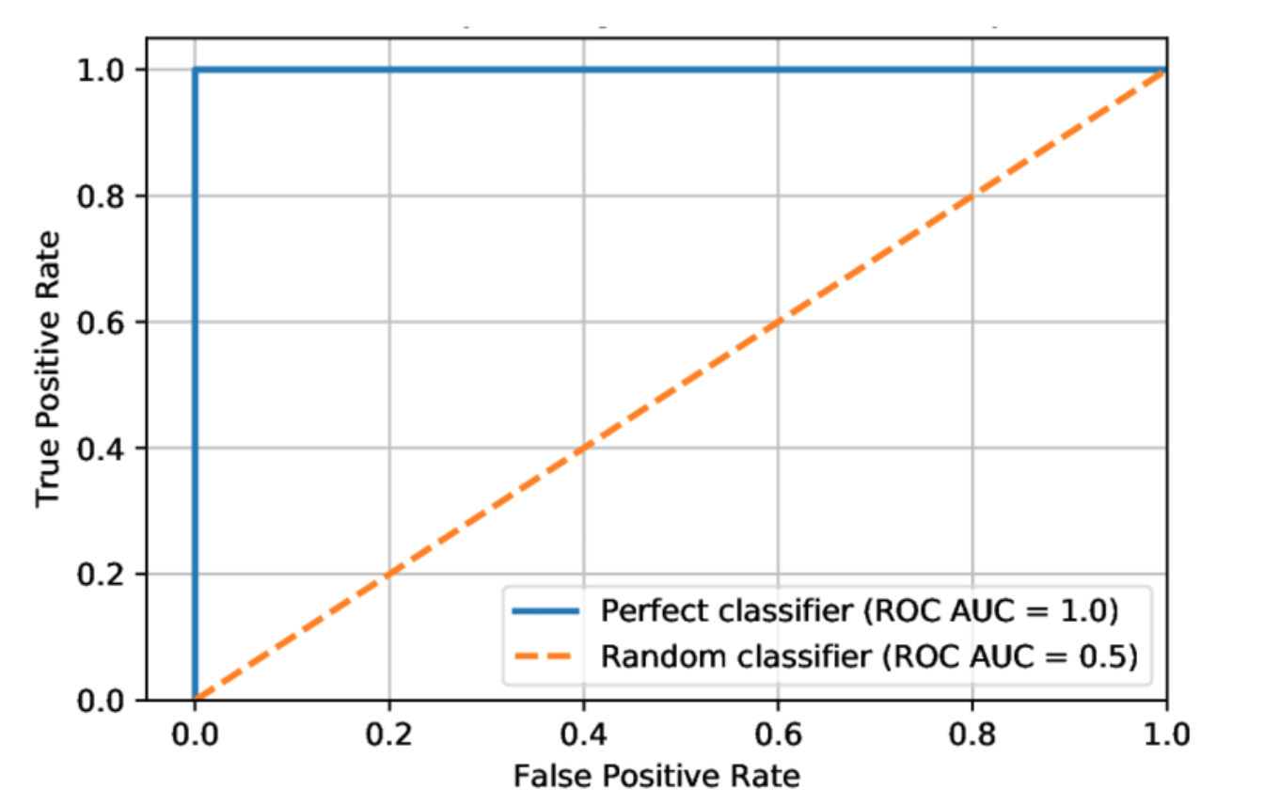
Sample ROC AUC

Slide 18
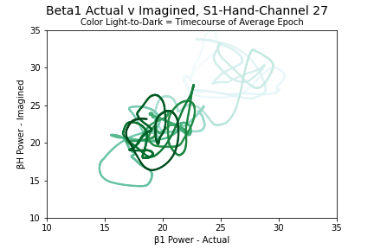
Aim 3

